Slide 1


Classification and Temporal Localization of Robbery Events in CCTV Videos through Multi-Stream Deep Networks
Zakia Yahya and Muhammad Muneeb Ullah
School of Electrical Engineering and Computer Science (SEECS)
16th IEEE International Conference on Smart Cities: Improving Quality of Life using ICT, IOT and AI
Charlotte, NC, USA

Slide 2
Outline
Problem Description
Proposed Model
The YouTube-Robbery Dataset
Experiments and Results
Conclusion

Slide 3
Opening Question!
How often do you hear about robbery incidents?

Slide 4


Problem Description
Robbery is an open social problem
Costs millions in financial losses as well as precious lives annually
E.g., on August 8, 2017, four robbers shot the bank manager dead and looted nearly 0.65 million PKR in Karachi, Pakistan
Bank manager killed during robbery in Karachi, Geo News
Source: https://www.geo.tv/latest/152863-private-banks-manager%20shot-dead-in-karachi
Notes:
Robbery in banks and shopping malls etc. is a big problem nowadays especially in Pakistan where still traditional CCTV cameras are used for security purpose.
But unfortunately robberies in banks and shopping malls are increasing day by day which not only cause loss of millions of rupees but lives as well. Currently the security mechanism that is used in our banks is not efficient due to dependence on human operator for decision.
Consequently, the CCTV footage are often consulted once a successful robbery has been carried out. Such incidents causes great
damage to public safety.

Slide 5
U.S. Bank Crime Statistics 2018 by FBI
Banks | Robberies | Burglaries | Larcenies
Commercial Banks | 2,707 | 47 | 2
Mutual Savings Bank | 5 | 0 | 0
Saving and Loan Association | 23 | 0 | 0
Credit Unions | 215 | 6 | 0
Armored Carrier Companies | 10 | 1 | 0
Unknown | 15 | 2 | 0
Total | 2,975 | 56 | 2
 | Injuries | Deaths | Hostages Taken
Total | 34 | 4 | 9
Source: https://www.fbi.gov/file-repository/bank-crime-statistics-2018.pdf/view

Slide 6

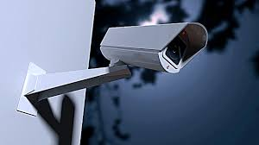
Conventional CCTV Surveillance
Primarily relies on a human observer
Continuous monitoring by human observers is impractical
CCTV surveillance should be completely automatic

Slide 7

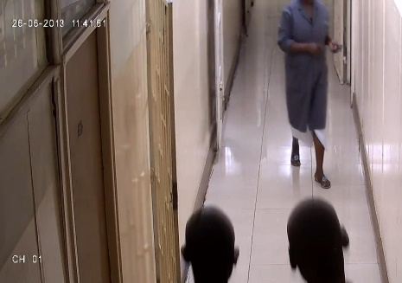
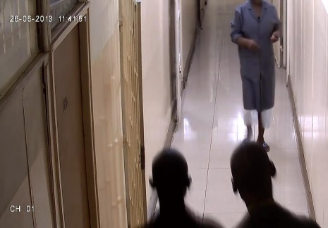
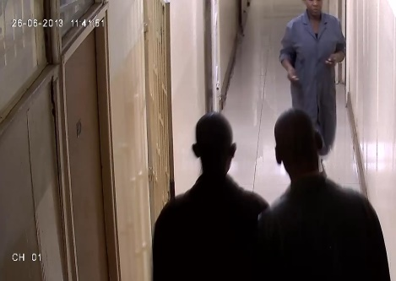
















Proposed Model
Input-video
sequences
Robbery
Detection
Deep-Streams
Appearance- Net
$$s_{1}$$
C3D
LSTM
Softmax
Motion-Net1
$$s_{2}$$
Optical
Flows
C3D
LSTM
Softmax
+
Late Fusion (averaging)
Motion-Net2
$$s_{3}$$
FG Mask
C3D
LSTM
Softmax

Slide 8
The YouTube-Robbery Dataset
Collected 124 untrimmed CCTV videos from YouTube comprising both robbery and normal activities
Some statistics:
# of Classes | 2
Total Videos | 124
Total Duration | 3 hours approx.
Average Video Duration | 79.54 sec.
Min Video Duration | 8 seconds
Max Video Duration | 408 seconds
Average Video Frames | 2060
Notes:
We have collected our own dataset of YouTube-Videos comprising robbery events in CCTV footages

Slide 9
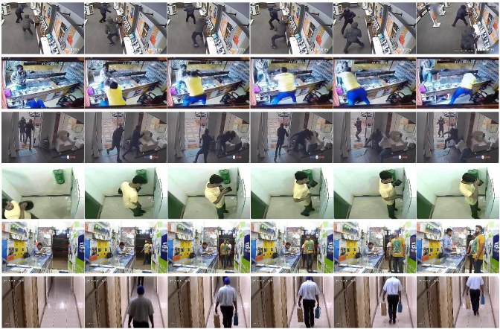
YouTube-Robbery : Sample Frames
Robbery
No Robbery

Slide 10
YouTube-Robbery : Train/Test Splits
Train | Robbery | No-Robbery | Total
Number of Videos | 40 | 40 | 80
Time (in minutes) | 59.39 | 58.88 | 118.28
Total # of Frames | 90, 495 | 94, 264 | 18, 4759
Test | Robbery | No-Robbery | Total
Number of Videos | 22 | 22 | 44
Time (in minutes) | 35.18 | 17.44 | 52.62
Total # of Frames | 56, 143 | 25, 707 | 81, 850

Slide 11
YouTube-Robbery : Annotation
Classification Task
Robbery/No-Robbery labels are assigned to each video
Localization Task
Divide each video into 3-seconds clips
Robbery/No-Robbery labels are assigned to each clip
Notes:
Binary annotation are made at video-level i.e. single label is assigned to whole untrimmed video for classification purpose
For localization task, we divide whole dataset videos into 3 seconds clips and then binary annotation are made at clip-level in order to mark temporal boundaries in untrimmed video

Slide 12
Experiments
We conduct two different types of experiments on the YouTube-Robbery dataset:
Classification Task
Robbery/No-Robbery labels are to be assigned to each test video
Prediction is considered correct if the assigned label matches with the ground truth label

Slide 13

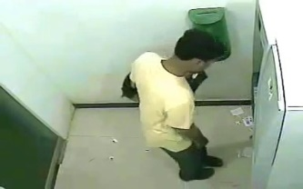



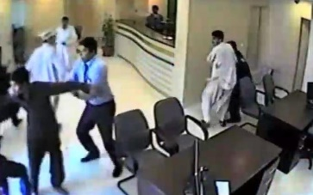


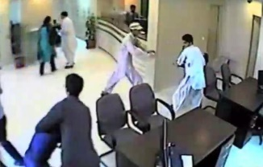

Classification Task (@Video)
Videos
No-Robbery
Robbery

Slide 14
Experiments
We conduct two different types of experiments on the YouTube-Robbery dataset:
Localization Task
Divide each test video into 16-frames clips
Robbery/No-Robbery labels are to be assigned to each test clip
Prediction is considered correct if the IoU >= 0.5 with the ground truth

Slide 15

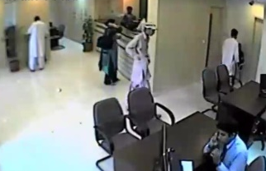
Localization Task (@Clip)
Clip 1
Clip 2
Clip 3
Clip 1
Clip 2
Clip 3
Videos
No-Robbery
Robbery

Slide 16
Benchmarking Methods
We have implemented several existing state-of-the-art methods for a comprehensive benchmarking
Conventional Approach
Improved Dense Trajectory features encoded with Fisher Vectors (IDT-FV) + SVM (Wang et. al. ICCV’13)
Deep Learning Approaches
C3D + SVM (Tran et. al. ICCV’15)
IDT-FV + C3D + SVM (Tran et. al. ICCV’15)
C3D + LSTM (Montes et. al. NIPS’16)
Two-Stream C3D + SVM (Diba et. al. ECCV’16)
Notes:
Binary annotation are made at video-level i.e. single label is assigned to whole untrimmed video for classification purpose
For localization task, we divide whole dataset videos into 3 seconds clips and then binary annotation are made at clip-level in order to mark temporal boundaries in untrimmed video

Slide 17
Results
Empirical results on the YouTube-Robbery dataset for two different types of experiments:
Effect of different visual inputs on the proposed model
Comparison with the state-of-the-art

Slide 18
Effect of Different Visual Inputs
Input Stream | C3D + SVM (%) @ Video @ Clip | C3D + LSTM (%) @ Video @ Clip
RGB | 52.27 51.01 | 63.64 58.59
FLOW | 70.39 67.41 | 72.73 77.62
FM | 59.09 65.27 | 70.45 78.40
Optical flow and foreground mask give the best results
C3D + LSTM outperforms C3D + SVM (especially in localization by about 13%)

Slide 19
Comparison with State-of-the-Art
Architecture | @ Video Accuracy (%) | @ Clip Accuracy (%)
IDT-FV + SVM | 72.73 | 75.71
C3D + SVM | 52.27 | 51.01
IDT-FV + C3D + SVM | 59.09 | 56.34
C3D + LSTM | 63.64 | 58.59
Two-Stream C3D + SVM | 72.73 | 64.76
Three-Stream C3D+LSTM | 75.00 | 73.89
Three-Stream C3D+LSTM outperforms one-Stream C3D+LSTM (11% @ Video and 15% @ Clip)
IDT-FV+SVM shows competitive performance in both tasks
Our model (Three-Stream C3D+LSTM) achieves the best accuracy (75.00%) in classification, whereas, competitive (73.89%) in localization

Slide 20
Conclusion
Deep models based on RGB and optical flow give superior accuracy
IDT-FV+SVM gives competitive results with limited training data as compared to the deep models
Our model (Three-Stream C3D+LSTM) could be trained end-to-end given significant amount of data is available
Our model could be used for transfer learning problems

Slide 21

Demo Video (contains violence!)

Slide 22
Thank You!
Zakia Yahya and Muhammad Muneeb Ullah
School of Electrical Engineering and Computer Science (SEECS)
16th IEEE International Conference on Smart Cities: Improving Quality of Life using ICT, IOT and AI
Charlotte, NC, USA

Slide 23
3D ConvNet (C3D)
3,16,112,112
64,16,56,56
256,4,14,14
512,1,4,4
Input-video
sequences
Pool 1
Pool 2
Pool 3
Pool 4
Pool 5
FC6
Conv 1
Conv 2
Conv 3b
Conv 5b
Conv 3a
Conv 4a
Conv 5a
Conv 4b
Zero Padding 1
224,224,3
4096
128,8,28,28
512,2,7,7
Notes:
This C3D [2] network is composed of 8 convolutional layers, plus 5 pooling layers, 2 fully-connected layers and a Softmax output at the end
We used C3D network as a feature extractor, due to its good performance in previous works
Video features are extracted from first fully-connected layer i.e. fc6 because it has been reported to work well for both image classification tasks and input feature for training a RNN

Slide 24
Effect of Varying the LSTM
Hidden cell units | RGB (%) @ Video @ Clip | FLOW (%) @ Video @ Clip | FM (%) @ Video @ Clip
64 | 52.27 58.07 | 70.45 77.13 | 65.90 78.25
256 | 56.82 58.19 | 68.18 77.37 | 70.45 78.33
512 | 63.64 58.59 | 72.73 77.62 | 70.45 78.40
1024 | 60.52 58.51 | 71.34 77.61 | 67.14 78.33
To select an appropriate configuration of LSTM for C3D + LSTM
Experimented with layers n = {1,2,3}, and cells c = {64, 256, 512, 1024}
Overall, best results with n = 1 and c = 512

